Slide 1
DBMS Quiz
by Brian Chen

Slide 2
1.
DELETE vs. TRUNCATE

Slide 3
DELETE vs. TRUNCATE
DELETE removes rows based on some condition given by the user
TRUNCATE removes all rows in a table without any condition

Slide 4
2.
Indexes in RDBMS

Slide 5
Indexes in Relational DBMS
An index inside of a RDBMS is an additional data structure
It associates a sorted copy of a column (or columns) to their respective rows of the database.

Slide 6
2.1 Pros and Cons of Indexes
Pros
Reduces the lookup time of queries from O(n) to O(logn) because indexes are sorted in order.
Cons
This is achieved at the cost of additional storage space because indexes use a B-Tree data structure to store data.

Slide 7
2.2 What Kind of Columns Should Be Indexed?
Columns that are queried often
Columns that are used to JOIN other tables
Columns used in the ORDER BY command
Columns that contain data with high selectivity.

Slide 8
3.
JOINs In SQL

Slide 9
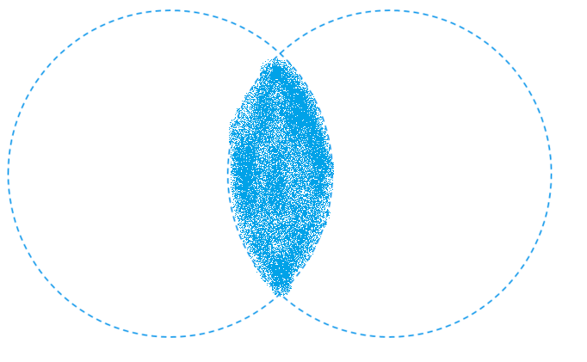
3.1 INNER JOIN
INNER JOIN returns a new table with rows of data from different tables that have the same value for a specific column

Slide 10
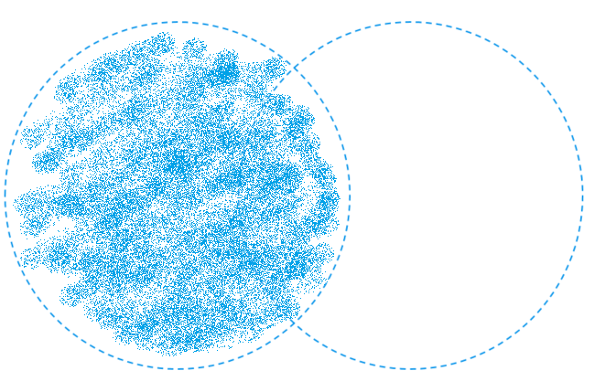
3.2 LEFT JOIN
LEFT JOIN returns a new table that consists of all rows of data from the first table, but now includes more columns of data from rows in table 2 that math a given condition.

Slide 11
3.3 RIGHT JOIN
Right join returns a new table that consists of all rows of data from the second table, but now includes more columns of data from rows in table 1 that match a given condition.

Slide 12
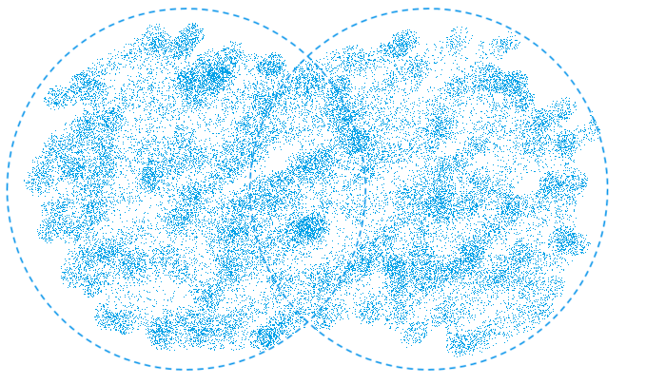
3.4 OUTER JOIN
OUTER JOIN returns a new table that consists of all rows and columns of data from tables 1 and 2, and in places where data from one table doesn’t have a respective data from another table, that space is left as NULL.

Slide 13
4.
GROUP BY / HAVING

Slide 14
4. GROUP BY/ HAVING
The GROUP BY command groups all values from a column into distinct groups of data.
The HAVING command further filters the resulting table from the GROUP BY command with certain condition

Slide 15
5.
SQL Practice

Slide 16
5. SQL Practice
Who’s the richest person?
Name | Money
John | 200
Mike | 500
John | 400
Jack | 300
Jack | 100
John | 150
Mike | 50

Slide 17
5. SQL Practice
SELECT * FROM person
WHERE Money =
(SELECT MAX(money) FROM person);
Name | Money
John | 200
Mike | 500
John | 400
Jack | 300
Jack | 100
John | 150
Mike | 50

Slide 18
6.
More SQL Practice

Slide 19
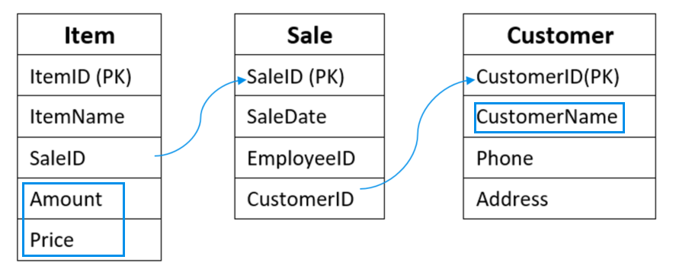
6.1 Which customer spends the most money?

Slide 20
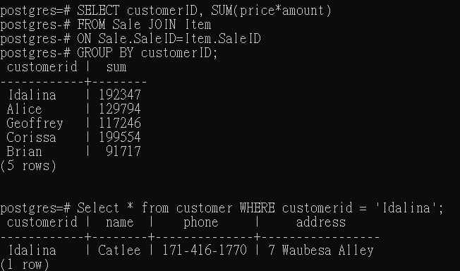
6.1 Which customer spends the most money?
SELECT customerID, SUM(price*amount)
FROM Sale JOIN Item
ON Sale.SaleID=Item.SaleID
GROUP BY customerID;
SELECT * FROM customer
WHERE customerid = { prev. }

Slide 21
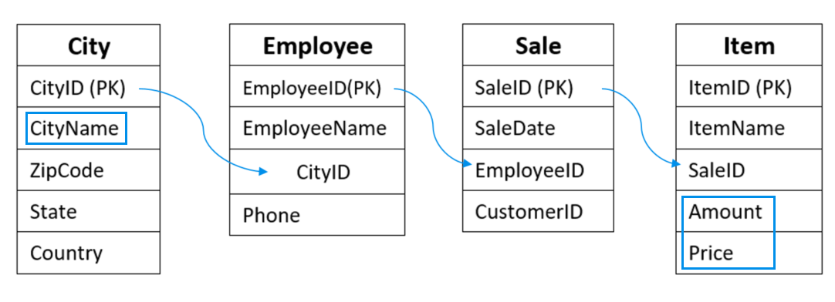
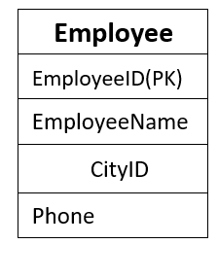
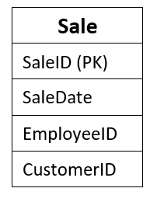
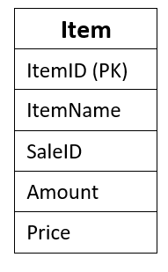
6.2 Which city contributes the least sales?

Slide 22
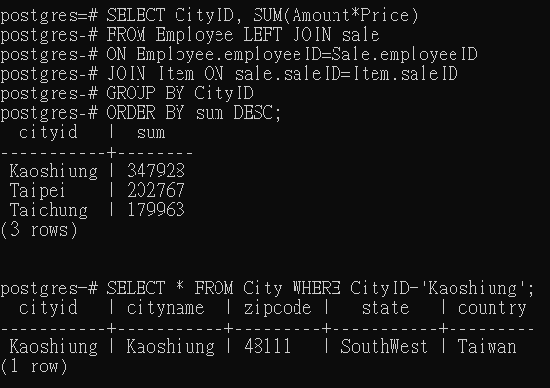
6.2 Which city contributes the least sales?
SELECT CityID, SUM(Amount*Price)
FROM Employee LEFT JOIN sale
ON Employee.employeeID=Sale.employeeID
JOIN Item ON sale.saleID=Item.saleID
GROUP BY CityID
ORDER BY sum DESC;

Slide 23
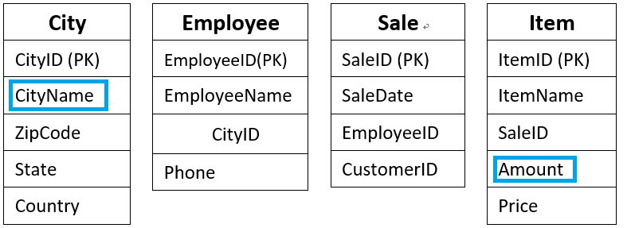
6.3 Which city sales the most amount of item “X”?

Slide 24
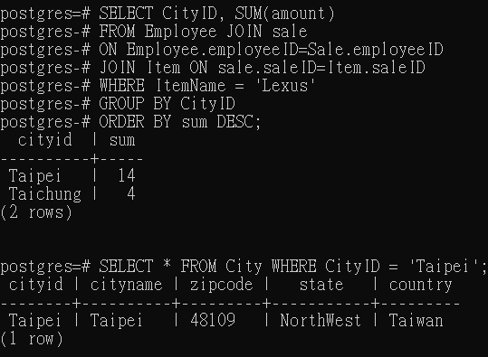
6.3 Which city sales the most amount of item “X”?
SELECT CityID, SUM(amount)
FROM Employee JOIN sale
ON Employee.employeeID=Sale.employeeID
JOIN Item ON sale.saleID=Item.saleID
WHERE ItemName = 'Lexus'
GROUP BY CityID
ORDER BY sum DESC;

Slide 25
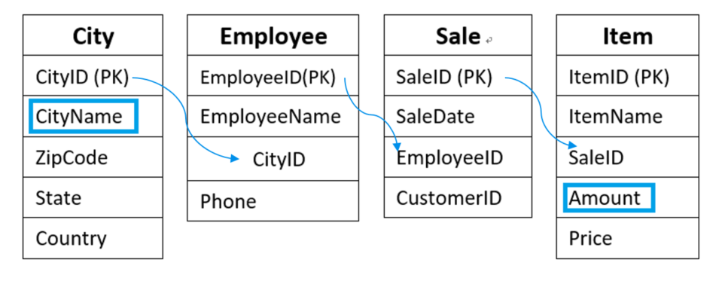
6.4 Who is the best seller in “Taipei”?

Slide 26
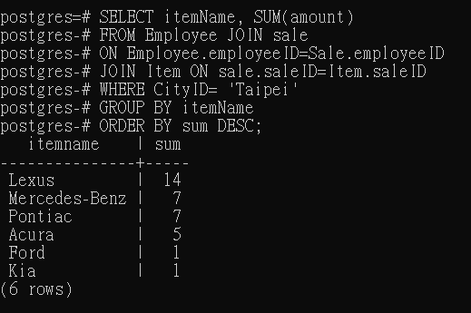
6.4 Who is the best seller in “Taipei”?
SELECT itemName, SUM(amount)
FROM Employee JOIN sale
ON Employee.employeeID=Sale.employeeID
JOIN Item ON sale.saleID=Item.saleID
WHERE CityID= 'Taipei'
GROUP BY itemName
ORDER BY sum DESC;

Slide 27
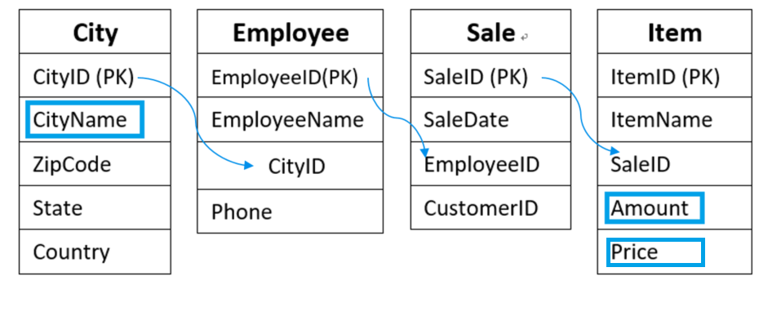
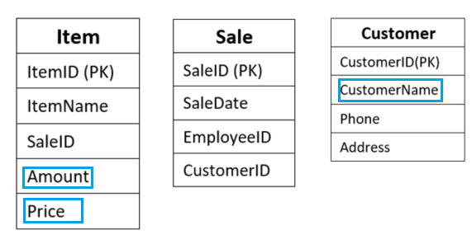
6.5 List people who spend more money than “the average spends of Taipei”.
AVG Spending of City
AVG Spending of customer

Slide 28
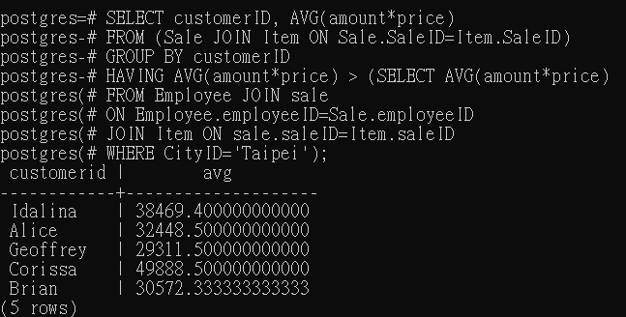
6.5 List people who spend more money than “the average spends of Taipei”.
SELECT customerID, AVG(amount*price)
FROM (Sale JOIN Item ON Sale.SaleID=Item.SaleID)
GROUP BY customerID
HAVING AVG(amount*price) >
(SELECT AVG(amount*price)
FROM Employee JOIN sale
ON Employee.employeeID=Sale.employeeID
JOIN Item ON sale.saleID=Item.saleID
WHERE CityID='Taipei');

Slide 29
7.
Medical Domain Quiz

Slide 30
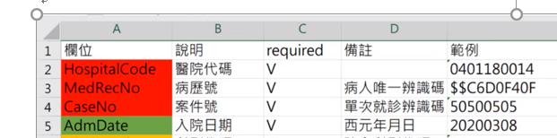
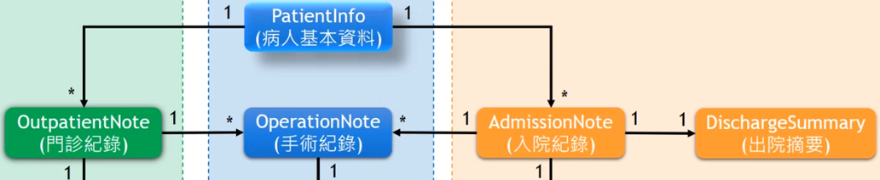
7.1 While we are looking for a certain record for certain patient on certain date, what would be the key variables for merge dataset?
MedRecNo
CaseNo
AdmDate

Slide 31
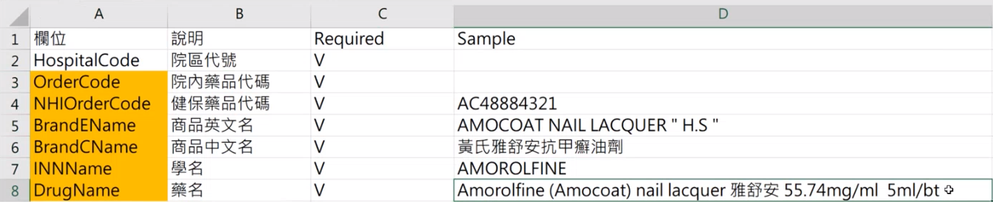
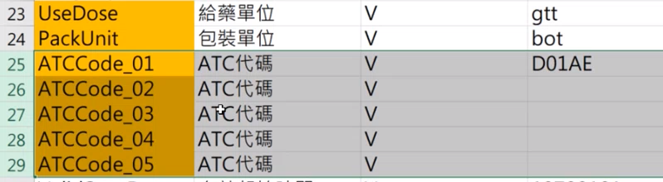
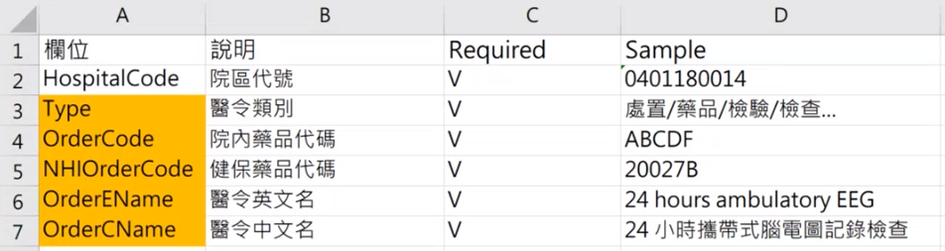
7.2 How to merge order code to the relevant product name and ATC code?
We can merge the OrderInfo and MedicationInfo tables through OrderCode

Slide 32
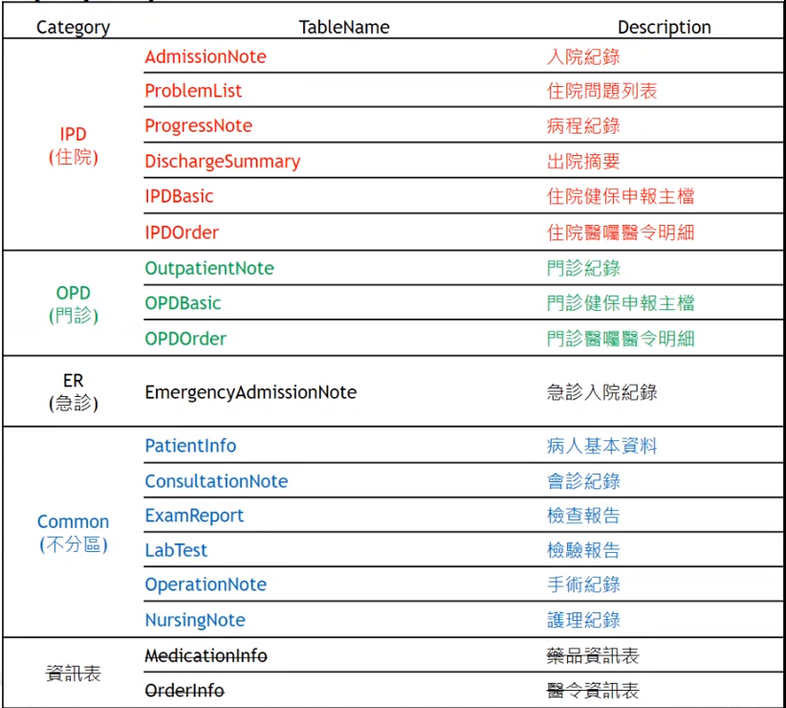
7.3 How many main categories for medical records, and what kind of datasets are in each category?
5 main categories: IPD, OPD, ER, Common, and Info

Slide 33
7.4 ICD-10-CM, ICD-10-PCS, ICD-9-DIAG, ICD-9-PROC. Which of the above are disposal codes? Which of the above are diagnostic codes?
ICD-10-PCS is a disposal code.
ICD-10-CM and ICD-9-DIAG are diagnostic codes.

Slide 34
7.5 SOMR vs POMR
POMR (Problem Oriented Medical Record) is a medical record format that focuses on a patient’s specific illnesses
SOMR (Source-oriented medical record) is a more conventional medical record format in which information is arranged according to the source of the data (different physicians, hospitals, etc.).

Slide 35
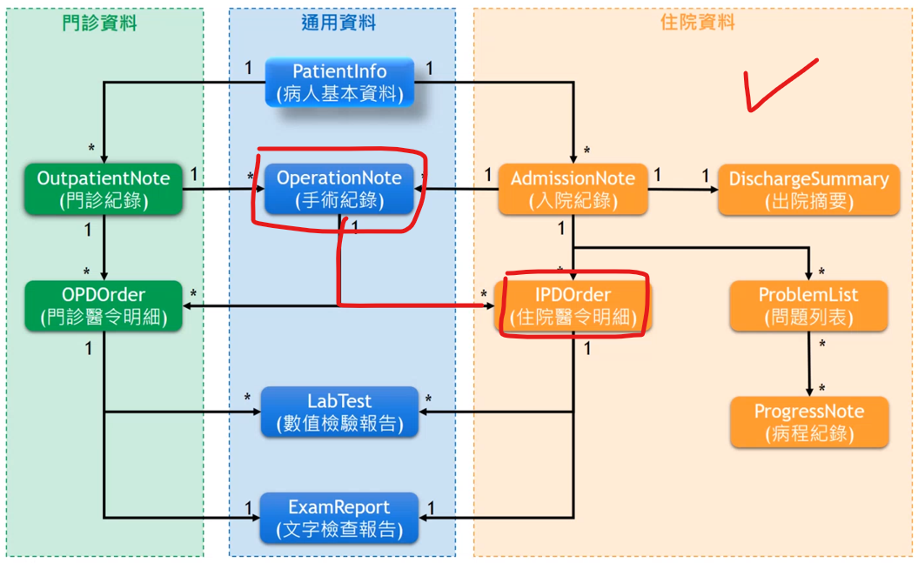
7.6 Does an OperationNote record correspond to an IPDOrder?

Slide 36
7.7 What is a consultation? What table would find ConsPurpose, ConsReport, ConDivisionid fields?
Consultation is the act of seeking assistance from another physician(s) or health care professional(s) for diagnostic studies, therapeutic interventions, or other services that may benefit the patient.
We can find ConsPurpose, ConsReport, ConDivisionid in the ConsultationNote table.

Slide 37
7.8 MedRecNo is used to identifying each record on PatientInfo. Is this statement appropriate? If not, what field should be used to uniquely identify each record?
Yes, MedRecNo is the unique key that can be used to identify each patient’s record in the PatientInfo table. It acts as the primary key of the table.

Slide 38

Thanks for Listening : )

